Slide 1
Team Project
Big Data System

Slide 2
Contents
Member
01
Requirement Analysis
02
Crawler
03
MongoDB
04
Query
05
Demo
06
QnA
07

Slide 3

Member
2014041030
손광호
Develop Crawler
Web
2014041044
박찬용
Develop Crawler
Web

Slide 4
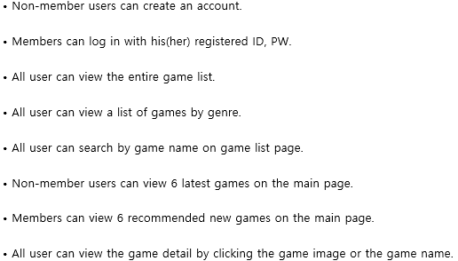
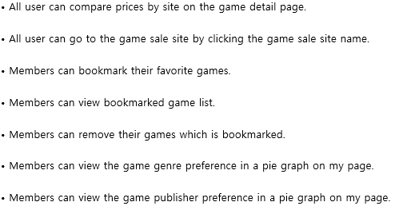
Requirement Analysis

Slide 5



Crawler

Slide 6
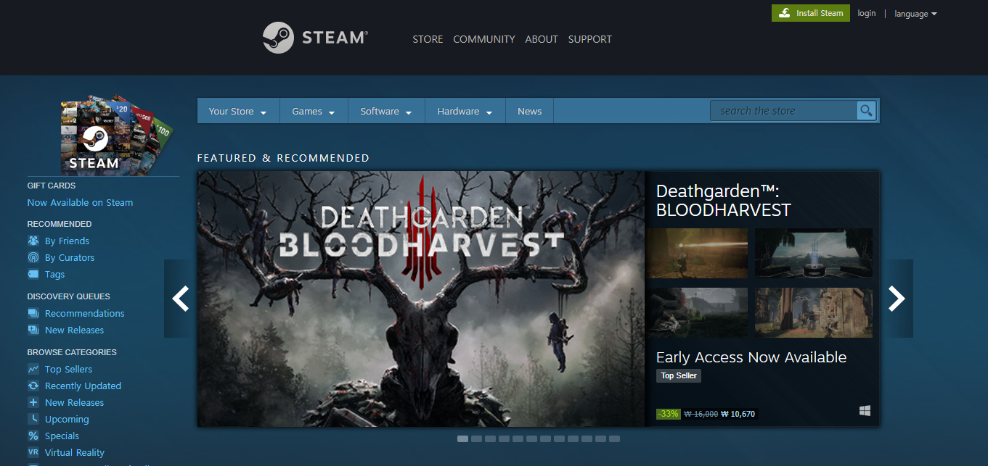
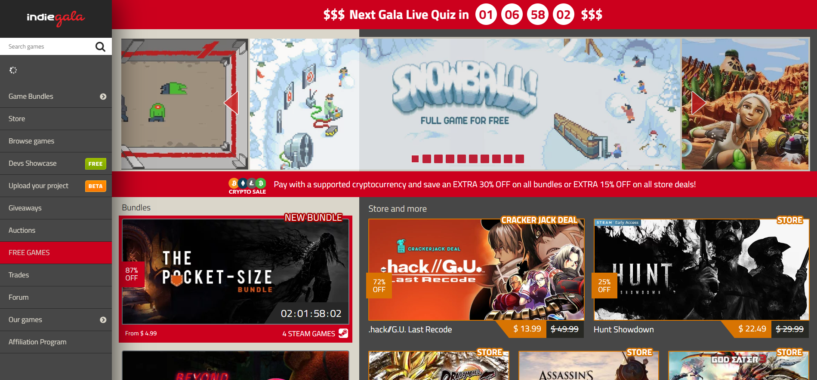
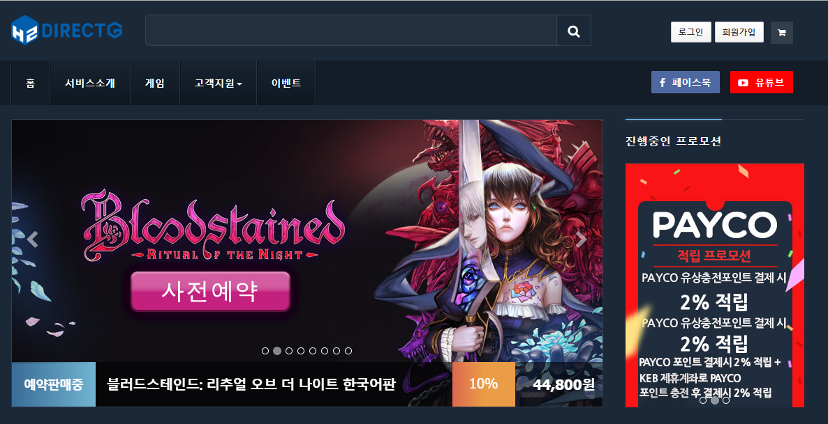
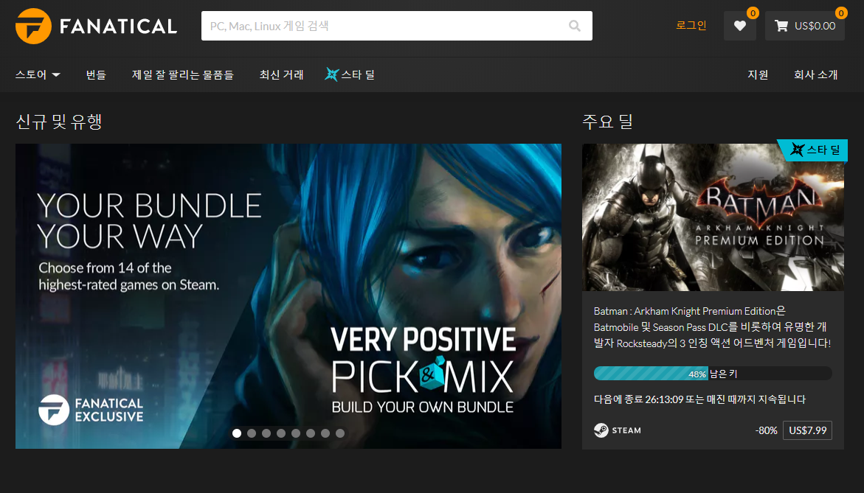
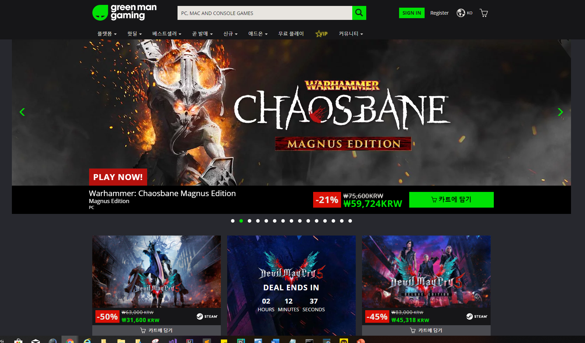
Crawler

Slide 7
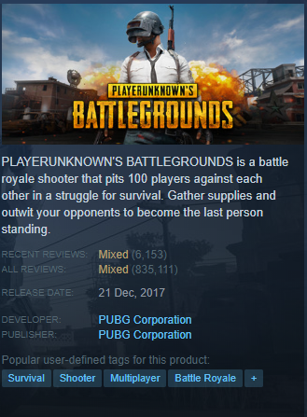
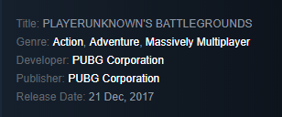
Crawler

Slide 8
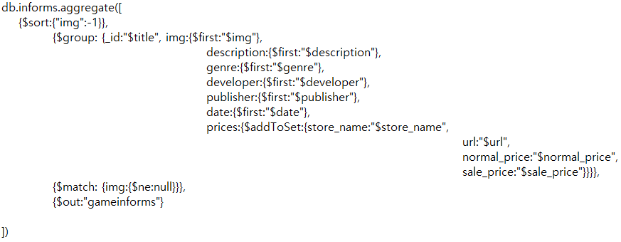
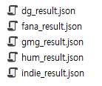
Crawler

Slide 9
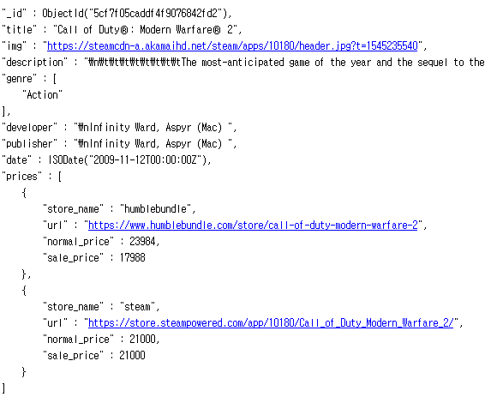
MongoDB
Game Inform
title
img
description
genre : [ ]
developer
publisher
date
prices : [
{
store_name
url
normal_price
sale_price
}, …
]

Slide 10
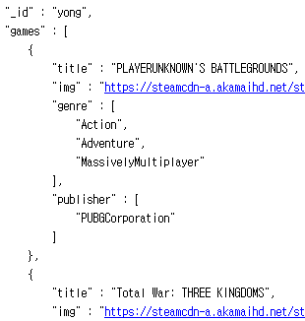
MongoDB
User
_id
games : [
{
title
img
genre: [ ]
publisher: [ ]
}, …
]

Slide 11
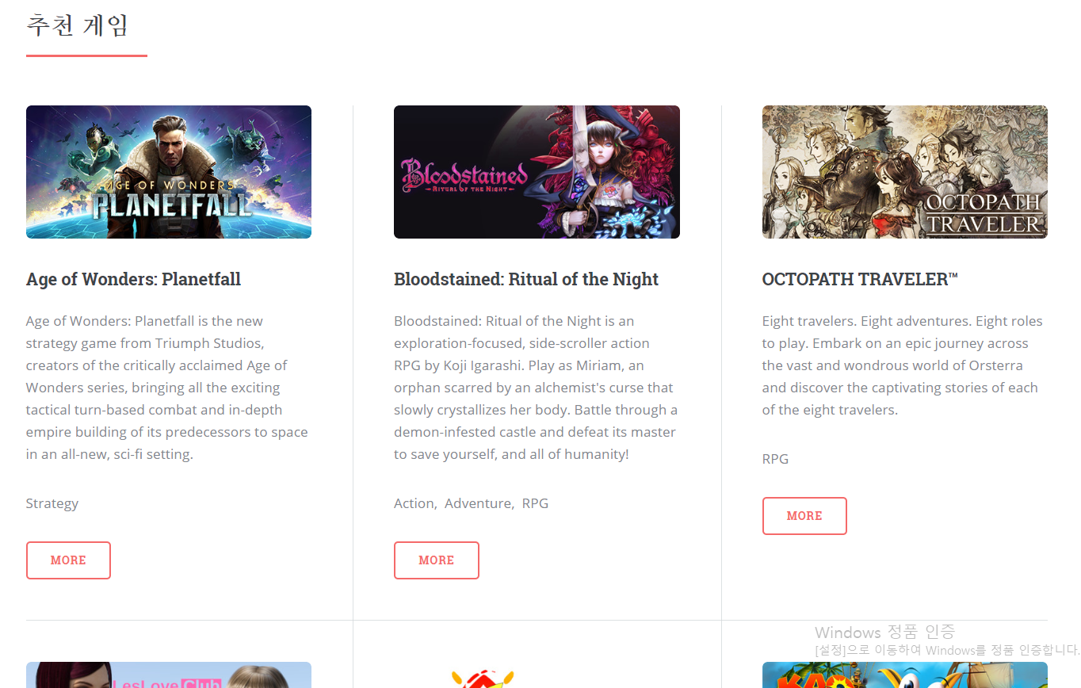
Query
Main Page
Non-member

Slide 12
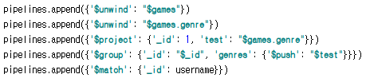
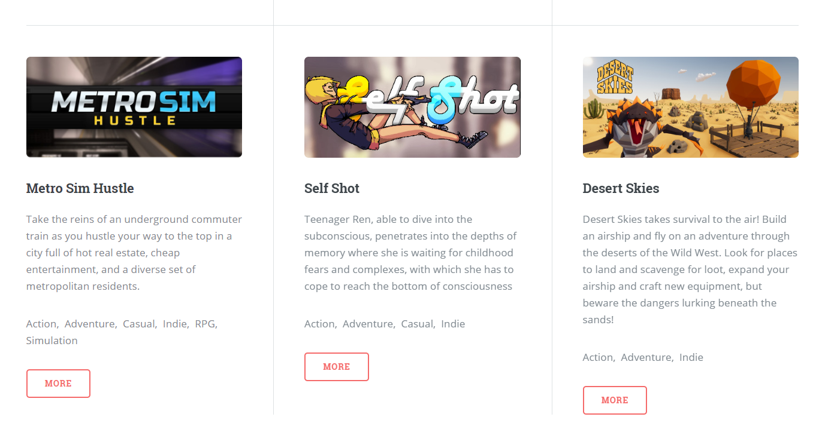
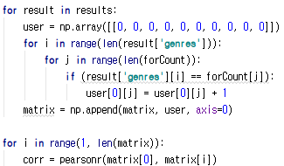
Query
Main Page

Slide 13
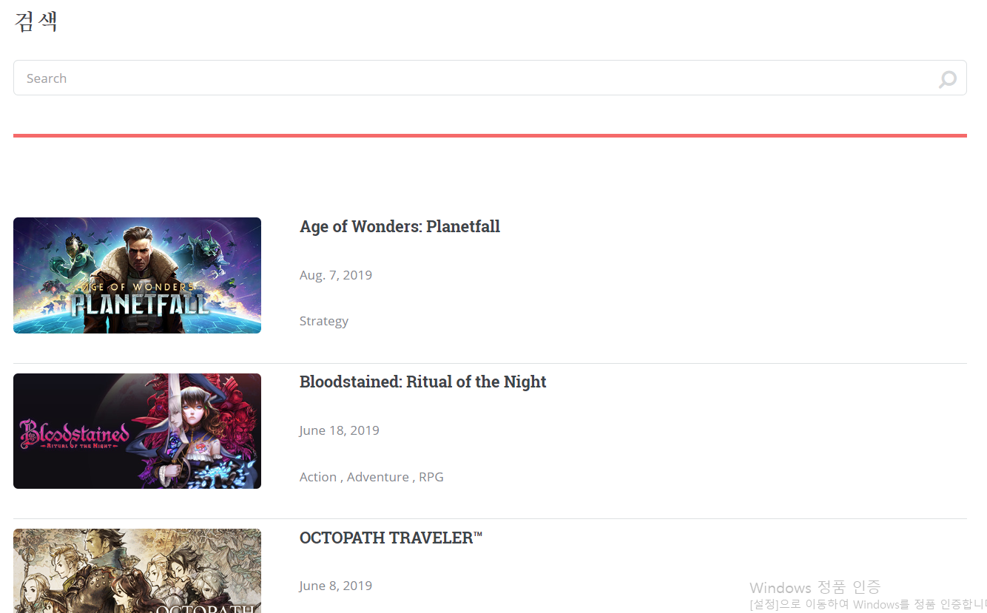
Query
Game List

Slide 14
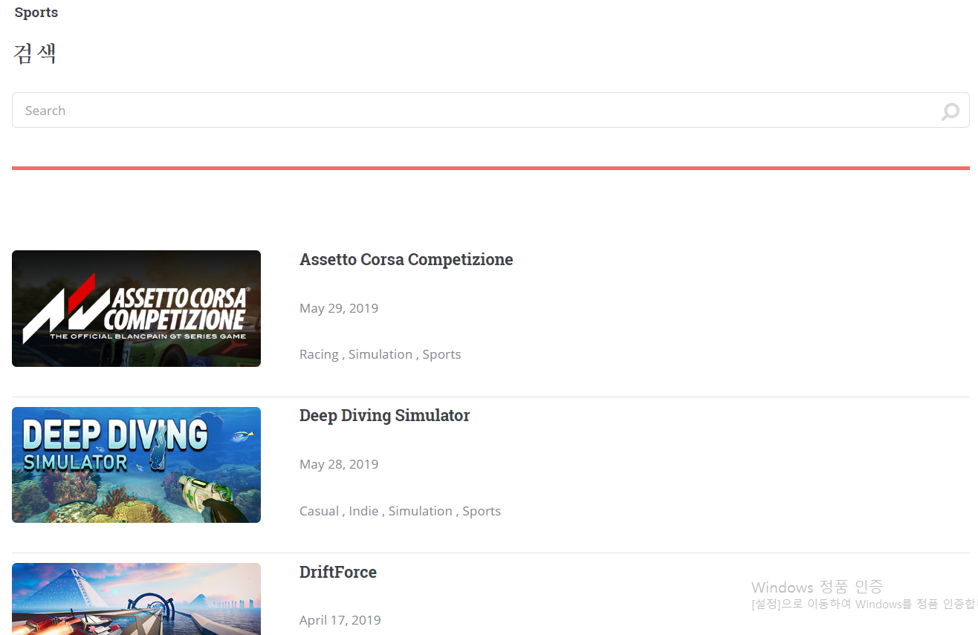
Query
Game List by genre

Slide 15
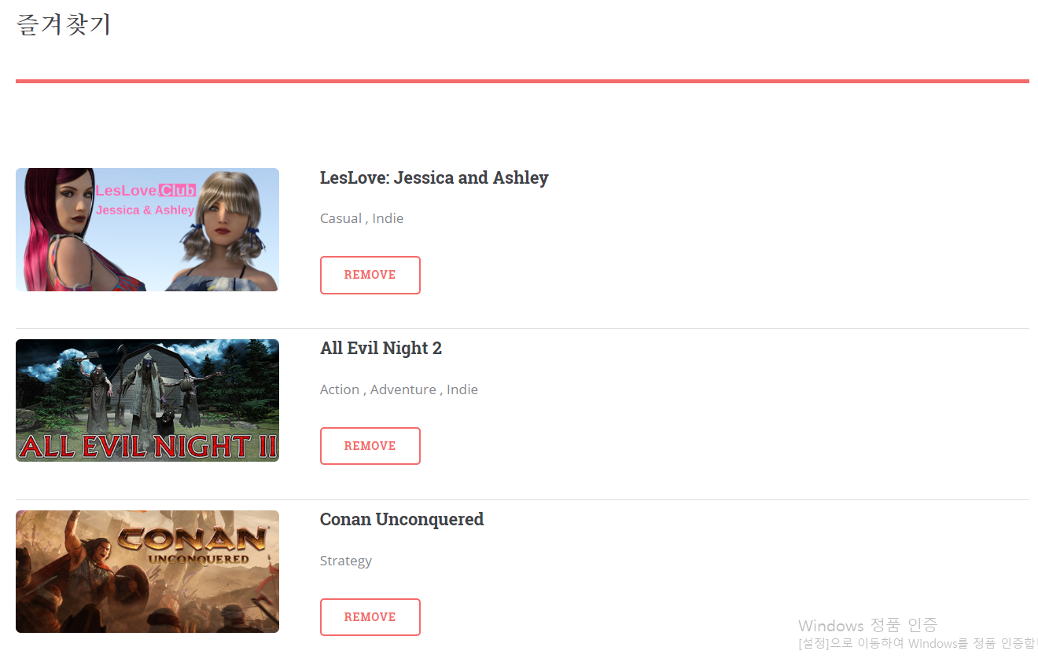
Query
Bookmark

Slide 16
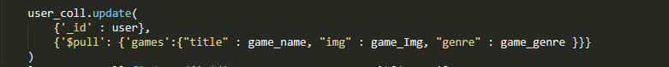
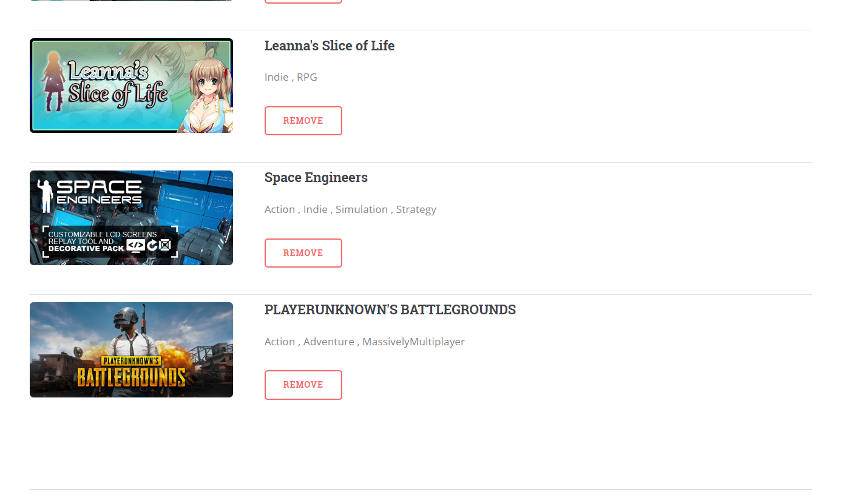
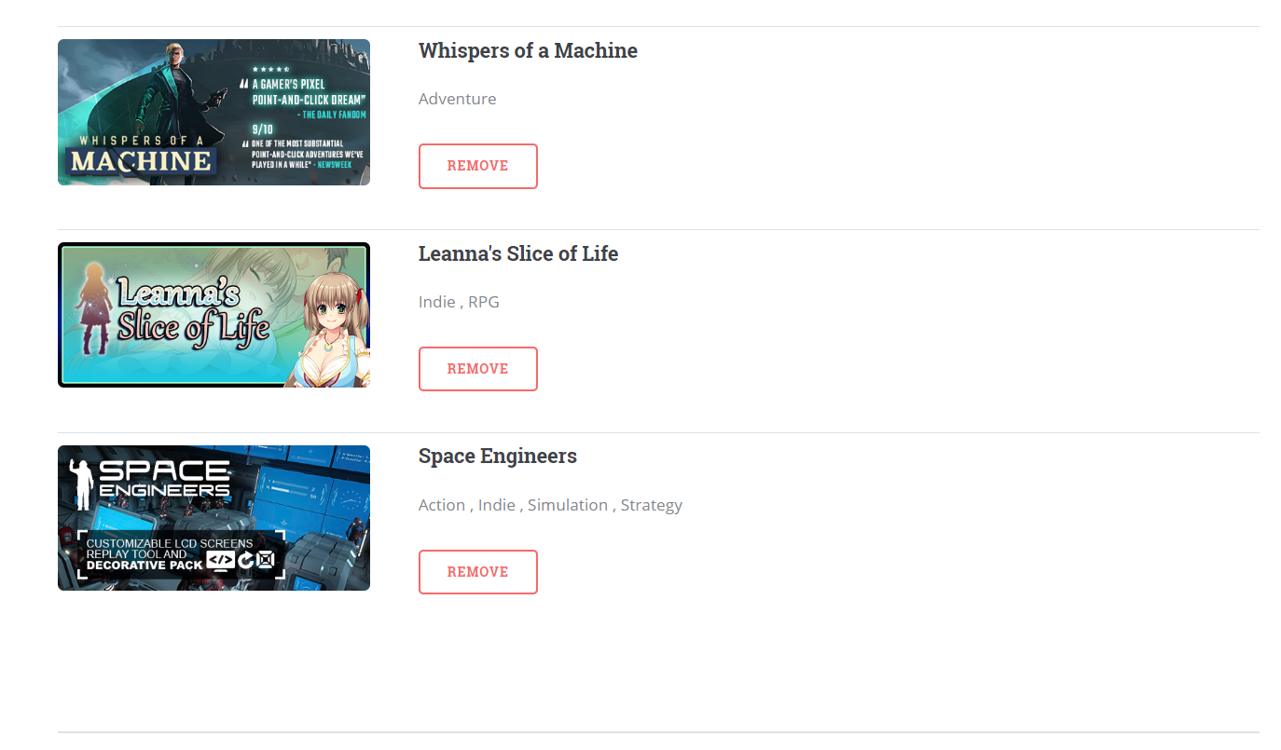
Query
Bookmark

Slide 17
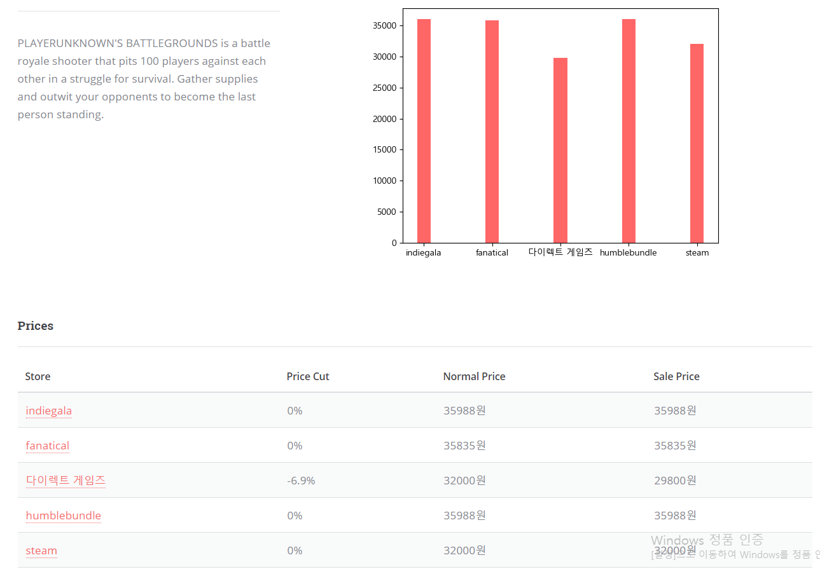
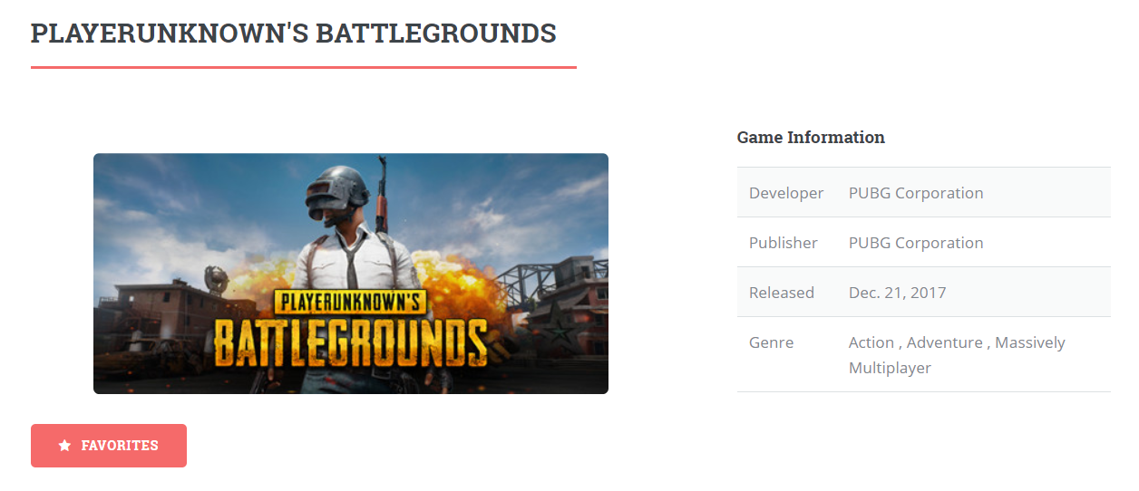
Query
Game Detail

Slide 18
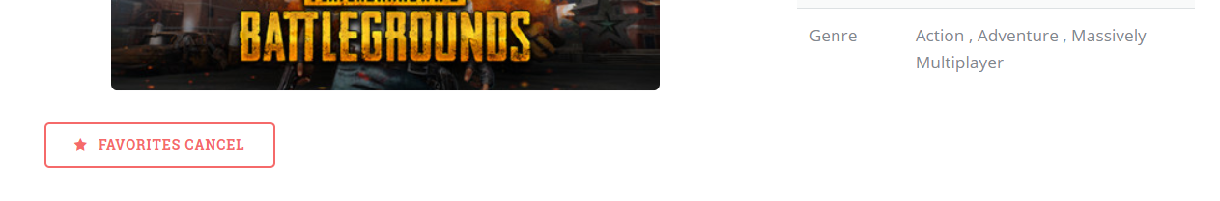
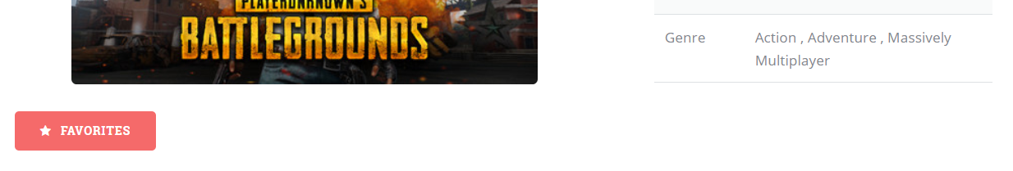
Query
Game Detail

Slide 19
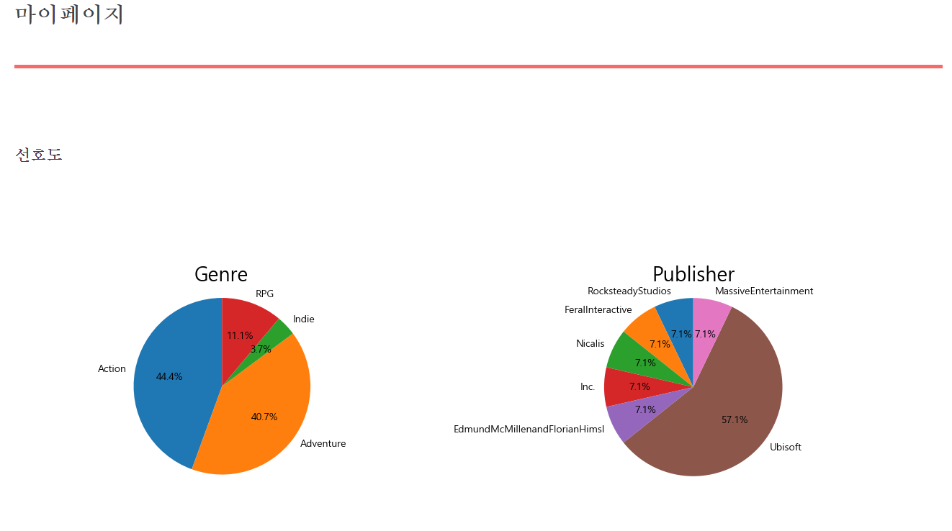
Query
My Page

Slide 20
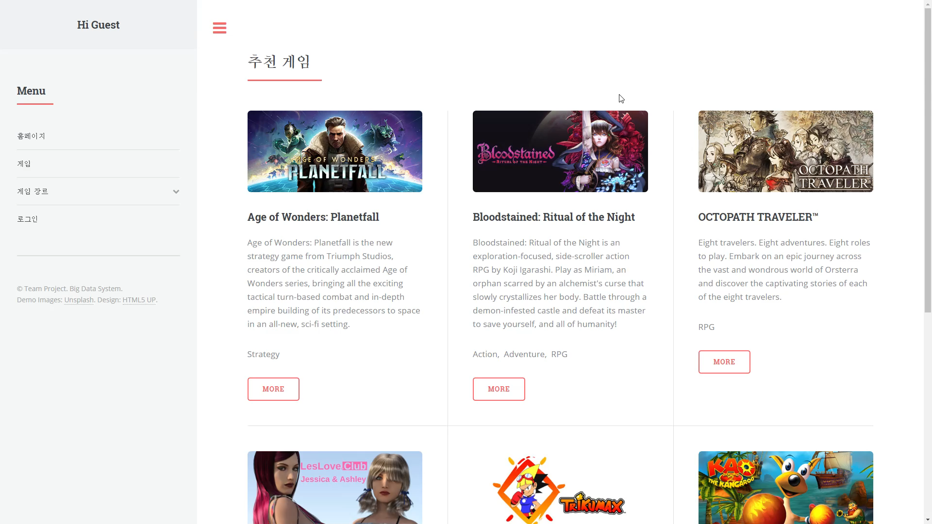
Demo

Slide 21
QnA

Slide 22
Thank you :-)

